Slide 1
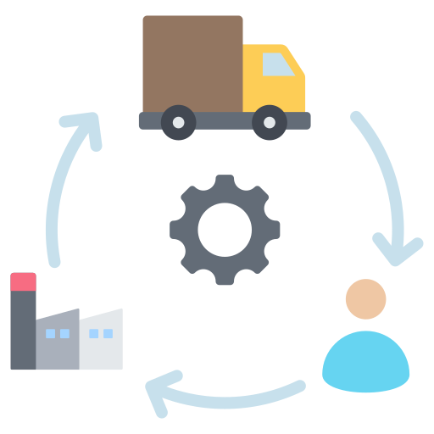
Centralized Application for Program Divisions for Drug Supply Chain

Slide 2

Process Flow– District Program Nodal Role
Nodal Receive Items from CMSS/MSO/Third Party:
A nodal unit receives supplies from various sources, including the CMSS, MSO or third-party vendors.
Enter the Received Items Details in the Generalized DVDMS Application:
After receiving the items, the nodal unit logs the details into the Generalized DVDMS application.
Store Inventory Updated:
Once the items are received, the DVDMS application updates the store’s inventory to reflect the new stock levels.
Issue Items to Sub Stores:
With the updated inventory, items are then issued to sub-stores that require these items.
Nodal receive items from CMSS/ MSO/ Third Party
Enter the received items details in the Generalized DVDMS application
Store Inventory updated
Issue items to Sub Stores

Slide 3
Miscellaneous Process
Add Inventory
Drug Transfer
Local Purchase and Challan Receive
CMSS Stock View

Slide 4
User Role – District Program Nodal Role
Nodal Role
Demand Mangement | Demand Generation
Procurement | Local Purchase
 | Local Challan Process
Inventory Management | Drug Inventory Add/ View
 | Receive from Third party
 | Indent Generation
 | Issue Desk
 | Acknowledge Desk
 | Issue To Sub Store Off Line
 | Issue to Third Party
 | Breakage and Lost Item
 | Physical Stock Modification
 | Condemnation Register
Drug Transfer | Transfer Request Excess
 | Transfer Request for Shortage
 | Item Wise Online Transfer Detail
 | Item Wise Transfer Acknowledge Desk
Go-Live In Phase - I
Inventory
Drugs Acknowledge (CMSS)
Indent Generation
Breakage and Lost Item
Receive/Issue Third Party
Issue To Sub Store Off Line
Drug Inventory Add /View
Drug Transfer
Item Wise Transfer Acknowledge
Item Wise Online Transfer

Slide 5
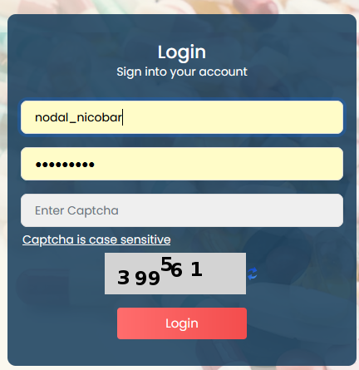
Login Steps
URL: https://dvdmsmscp.uat.dcservices.in/IMCS/login
Username : nodal_nvbdcp (District level ID)
Password : admin@123
Each Nodal have their Username/password according to role
Refresh the captcha

Slide 6
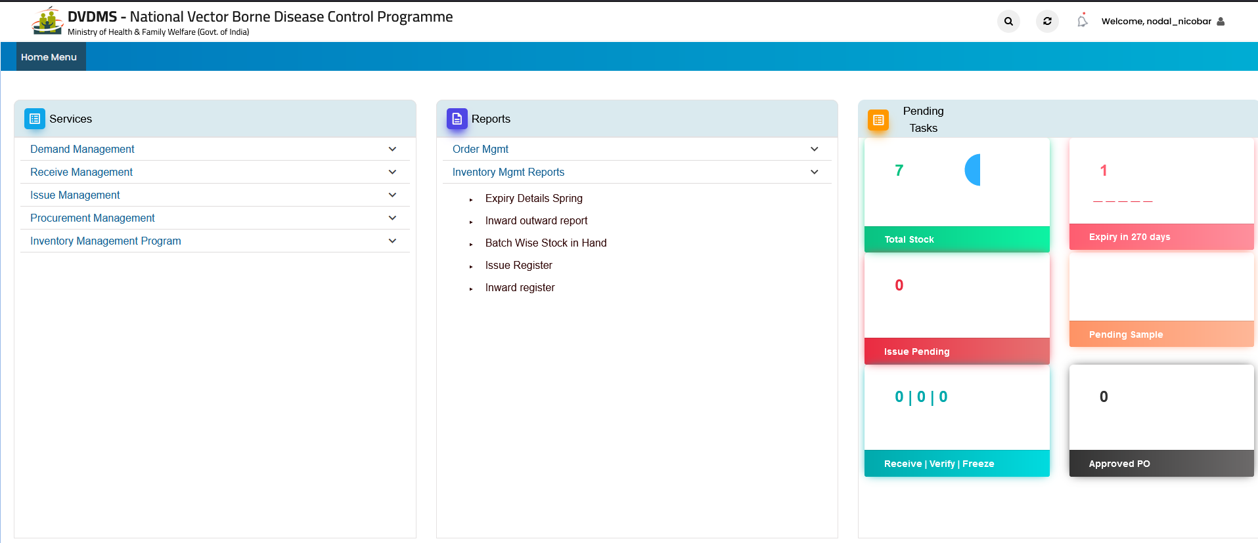
Login Steps

Slide 7
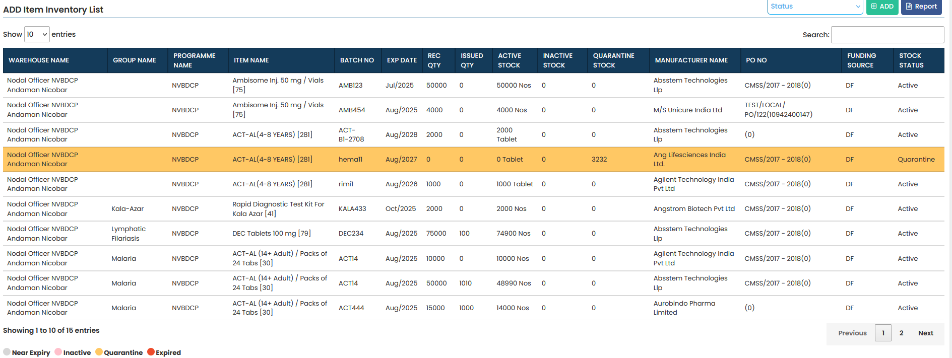
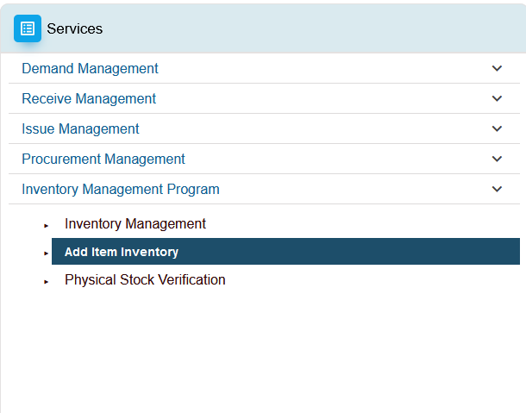
Ground Stock Entry
Ground stock upload—Services/Inventory Management – Add Inventory

Slide 8
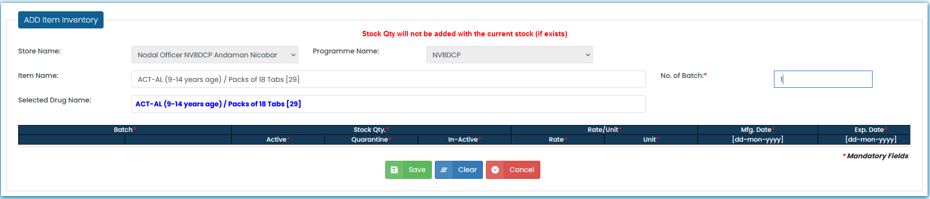
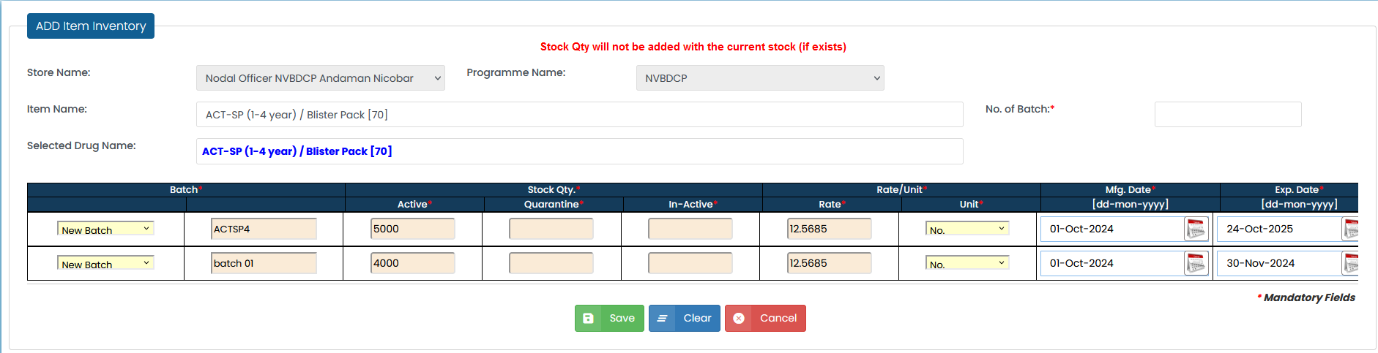
Ground Stock Entry
Add Inventory

Slide 9
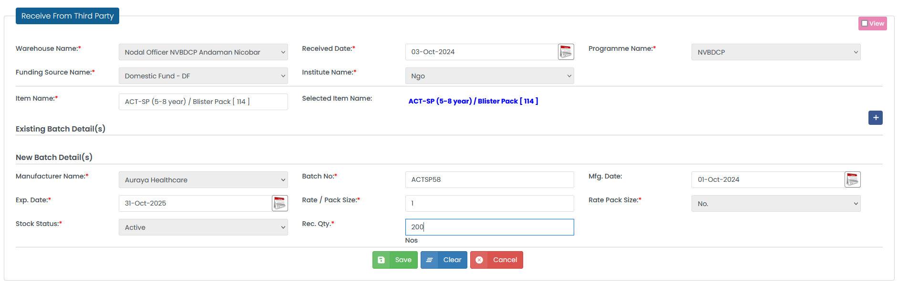
Go-Live Steps
Receive Drugs from - CMSS/Third party/MSO
Receive Third party

Slide 10
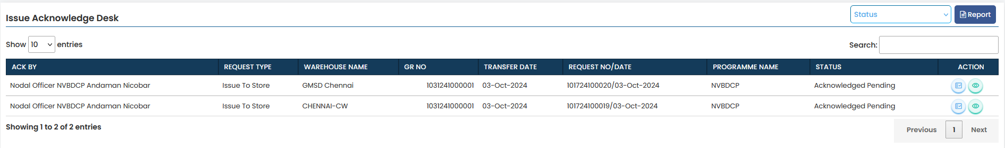
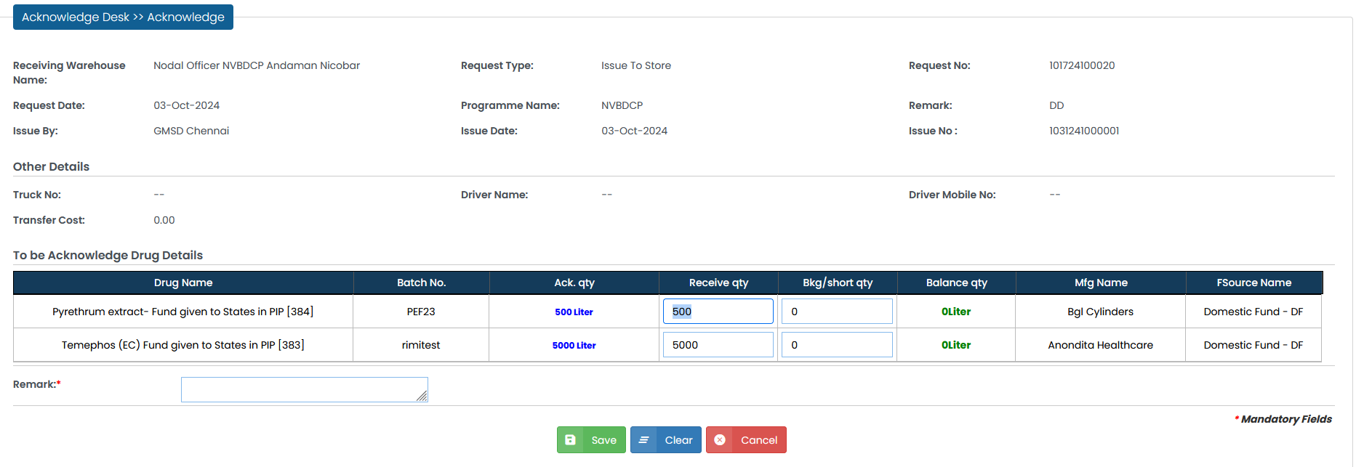
Go-Live Steps
Receive Drugs from - CMSS/Third party/MSO
Receive CMSS/MSO

Slide 11
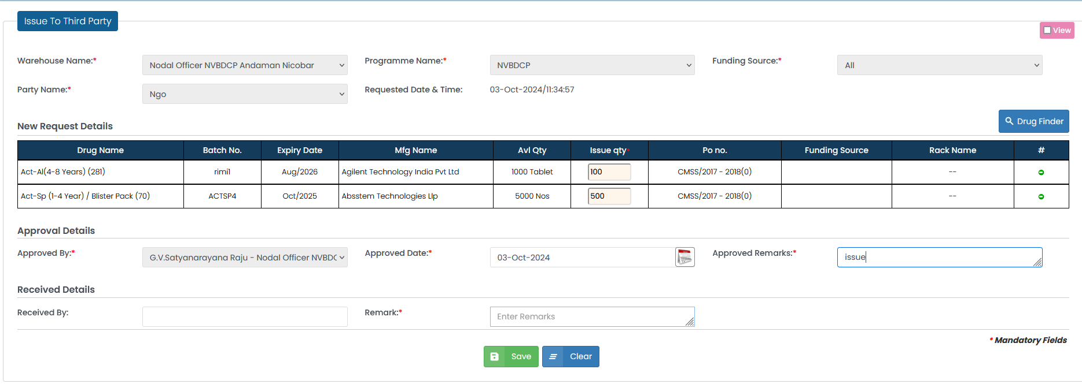
Go-Live Steps
Distribute Drugs to - DH/CHC/PHC/Third party
Issue to Third Party

Slide 12
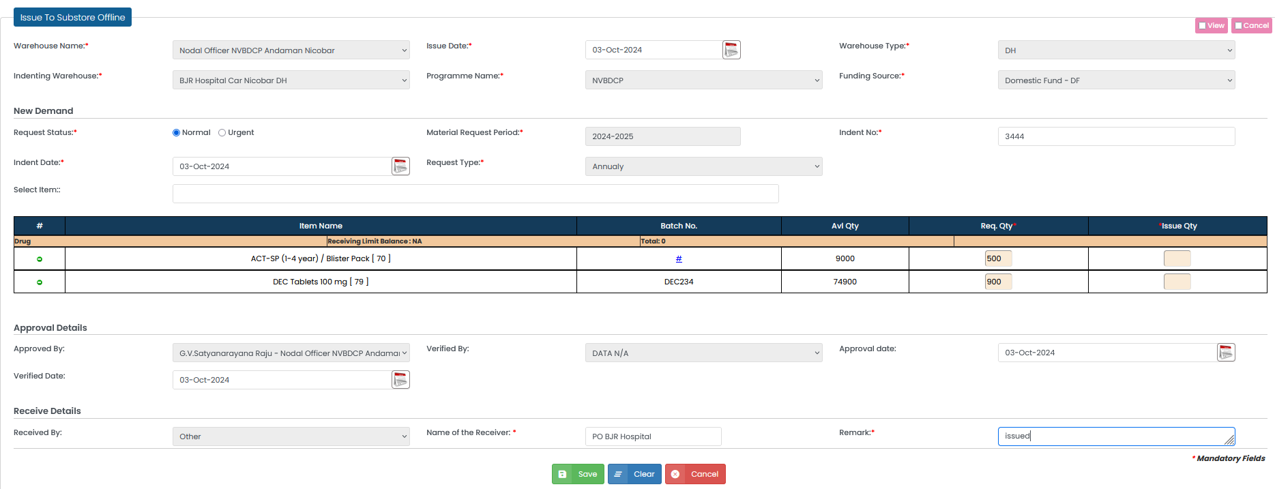
Go-Live Steps
Distribute Drugs to - DH/CHC/PHC/Third party
Issue to Sub-Store

Slide 13
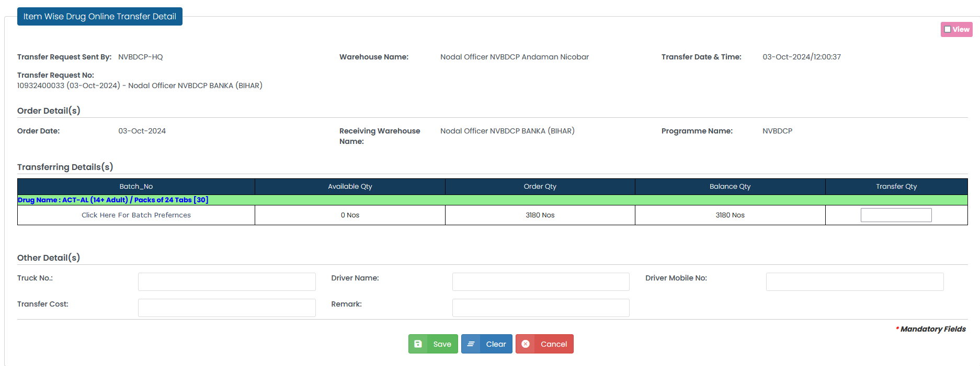
Go-Live Steps
Drugs Transfer
Issue to Nodal

Slide 14
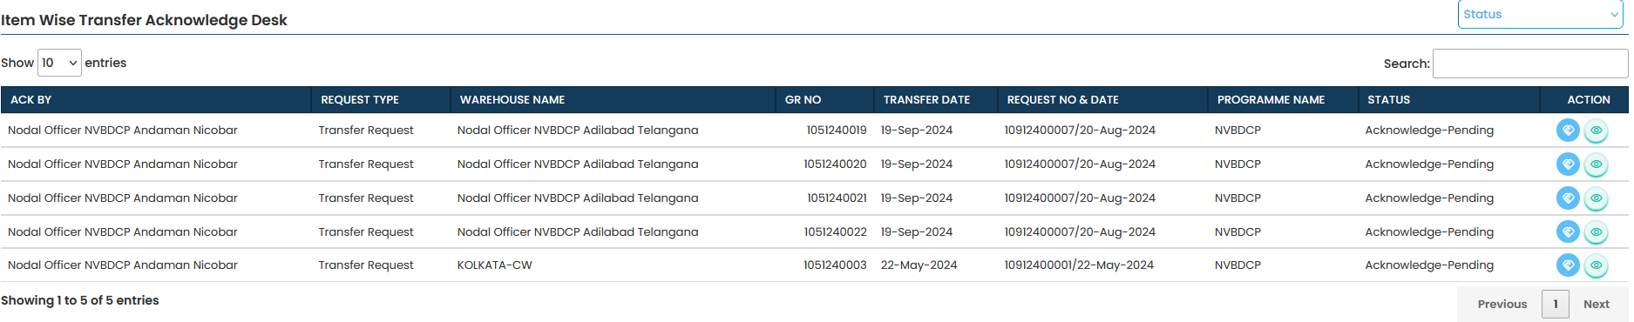
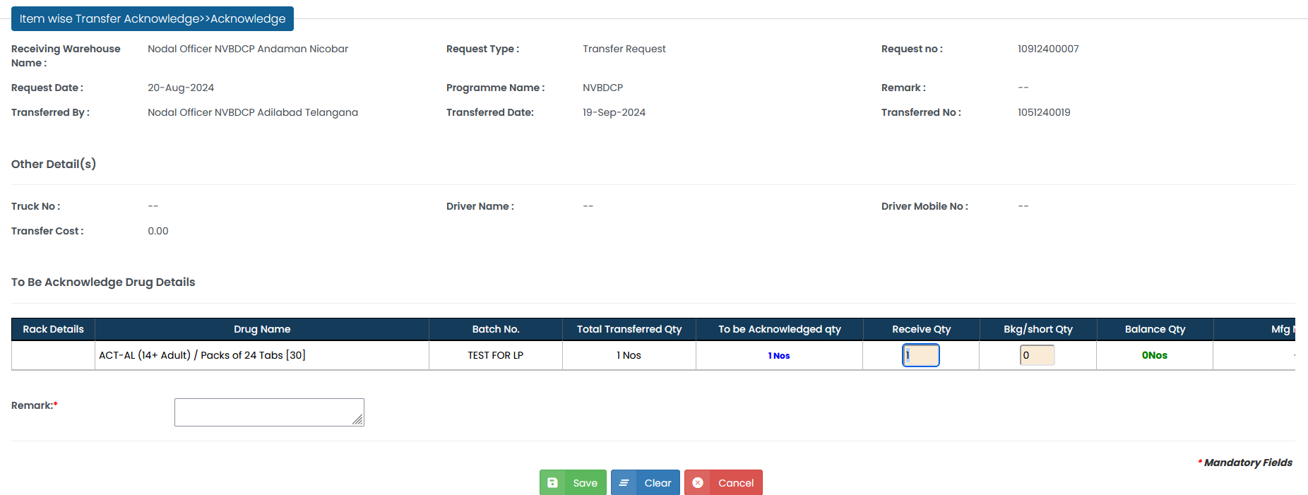
Go-Live Steps
Drugs Transfer Acknowledge
Transfer Receive

Slide 15
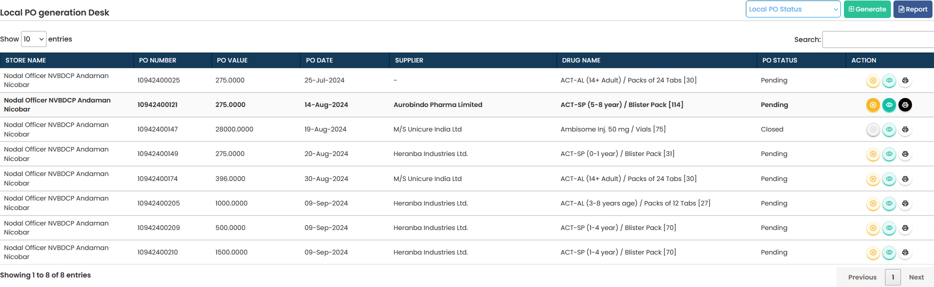
Go-Live Steps
Local PO

Slide 16
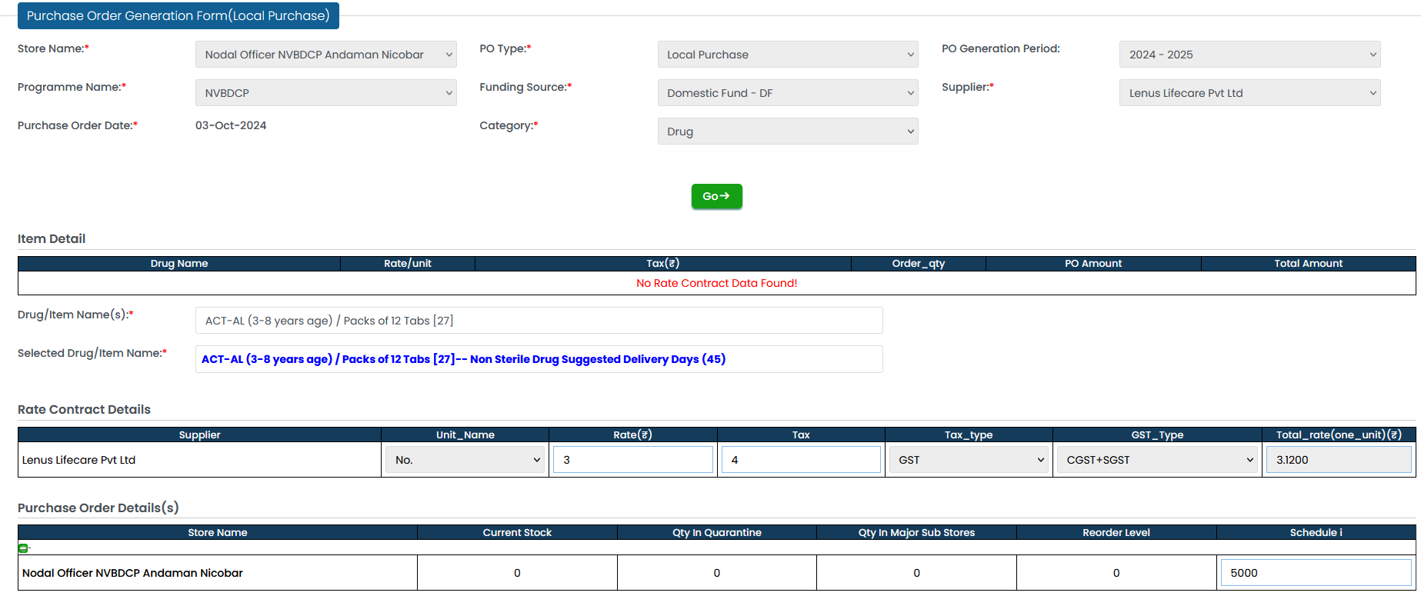
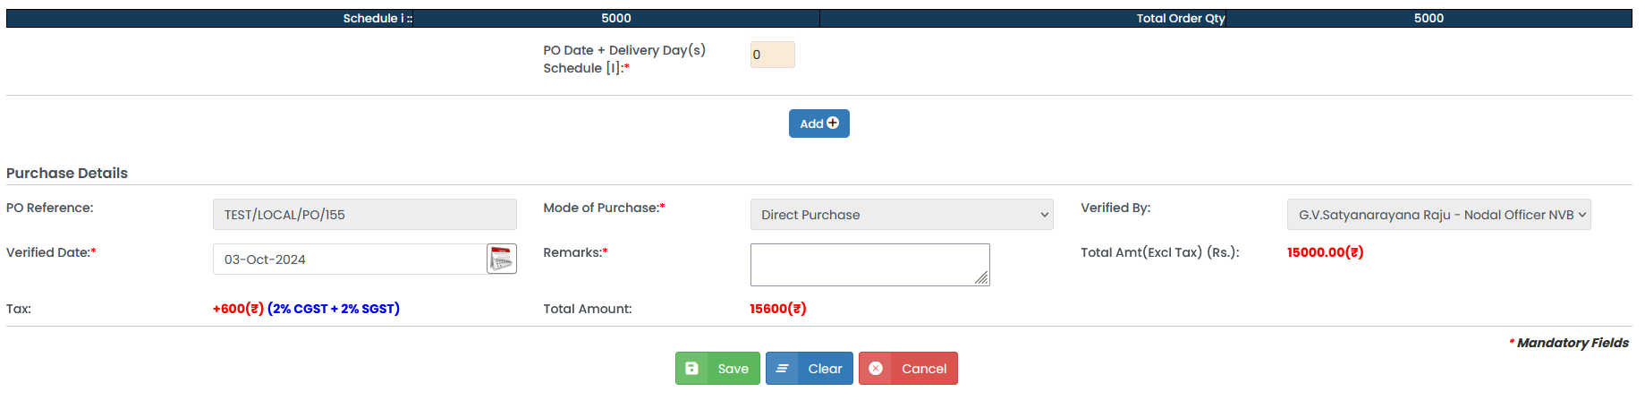
Go-Live Steps
Local PO

Slide 17
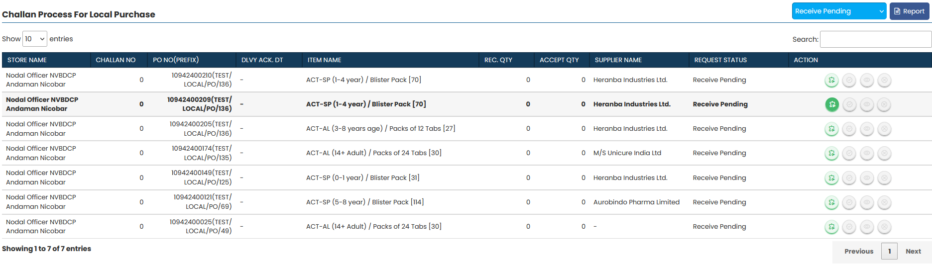
Go-Live Steps
Local PO Challan List

Slide 18
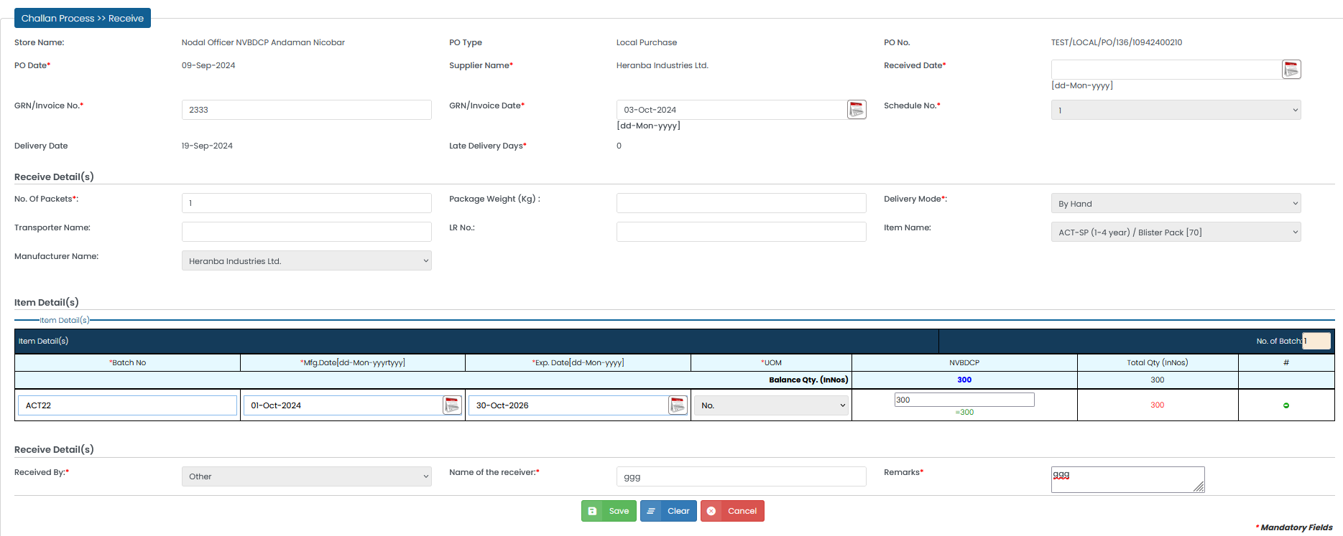
Go-Live Steps
Local PO Challan

Slide 19
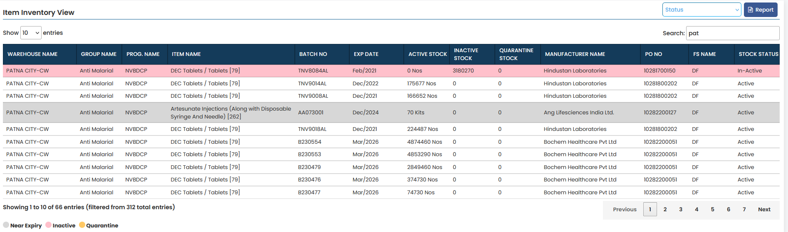
Go-Live Steps
CMSS Stock View

Slide 20
Thank you

